Slide 1
Intern Presentation AUTOMATED REGRESSION ENVIRONMENT FOR DESIGN VERIFICATION PRODUCTIVITY
11th November 2016
Keshav Rath

Slide 2
OBJECTIVE
The main aim of this project is to write a common script which could work across all kinds of verification projects making it easier to operate and get the result without changing the script at all. This script is developed so as to get all the input from the user which would result in an OUTPUT which are similar in structure across all projects

Slide 3
BACKGROUND
Prior to this script, there used to be multiple scripts, each of them customized for a specific project. Each of these scripts used to produce an output which used to differ from the other.
Project 1
Project 2
Project 3
…………..
Project N
Script 1
Script 2
Script 3
…………..
Script N
Qualified Result 1
Qualified Result 2
Qualified Result 3
…………..
Qualified Result N

Slide 4
DISADVANTAGES
Script customized for each project
Not easy to maintain
Learning Cycles Huge.
Not PBS friendly
Longer Simulation Cycles

Slide 5
AUTOMATION FRAMEWORK OVERVIEW
To overcome this problem a script was developed which can work across all projects.
This script is developed so as to get all of the inputs from users.
Project 1
Project 2
Project 3
…………..
Project N
User Inputs 1
User Inputs 2
User Inputs 3
…………..
User Inputs N
Script
Qualified Result 1
Qualified Result 2
Qualified Result 3
…………..
Qualified Result N

Slide 6
SALIENT ATTRIBUTES OF SCRIPTS
Unified Features
User driven inputs
PBS friendly
Uniform Outputs as test results
Faster Simulation

Slide 7
DIRECTORY STRUCTURE
ROOT PROJECT
Design
Verification
Env_source
Regression
Scripts
Sim
Testbenches
Testcases
EXECUTION FOLDER FOR SCRIPT

Slide 8
OPTIONS
Options that can be given by users to execute this script
MANDATORY
Single / Regression
Timescale
Frtl
Ftb
Sim_mode
Tool
Inclist
NON MANDATORY (EXTRA)
Options (Extra)
Deflist
Vip_library
Optional Error
Optional Error Exclude
Seed
Verbosity
Stop Time
Log name
GUI
Excel
Vsim_do
Vsim_options
Dump
No of Licenses
PBS
Queue
Coverage
VIP Dir Change
Lib Link
Lib Link File
Language (Verification)
Help
Readme
Compile_again
Vcom_options
REGRESSION ONLY
SINGLE ONLY
MODELSIM ONLY

Slide 9
EXECUTION PROCEDURE
First go to the script folder
Two methods of executing
Using the command line code
For Single Test
perl test.pl -vtimescale 1ns/100fs -tool ncsim -ftb tb_list.txt -inc inclist.txt -frtl files.f –test top_test -sim_mode ncsim -vip_library vip_lib_content.fl -deflist deflist.fl -options options.fl -opt_error error.fl -language UVM -gui -excel
For Regression
perl test.pl –vtimescale 1ns/100fs -tool ncsim -ftb tb_list.txt -inc inclist.txt -frtl files.f -reg reglist.fl -sim_mode modelsim -vip_library vip_lib_content.fl -deflist deflist.fl -options options.fl -opt_error error.fl -language OVM –pbs –no_of_licenses 2 -excel
Using the makefile/Makefile
make single (for single test)
make reg_excel (for regression list)
If script needs to be executed from other directories
make –C ../scripts reg_pbs_excel (if run from directory other than script)

Slide 10
FILES INSIDE SCRIPT DIRECTORY
Scripts
Incdir List
Script (PERL)
Testbench Filelist
Mandatory Reg Options
RTL Filelist
Mandatory Single Options
Define List
Optional Reg Options
Extra Options List
Optional Single Options
Tcl Files
Mandatory Compile Options
Makefile
Help Text
Optional Error
Optional Error Exclude
Imc_code.cmd (COVERAGE)
Clean.sh

Slide 11
SOME IMPORTANT FILES IN SCRIPT DIRECTORY

Slide 12
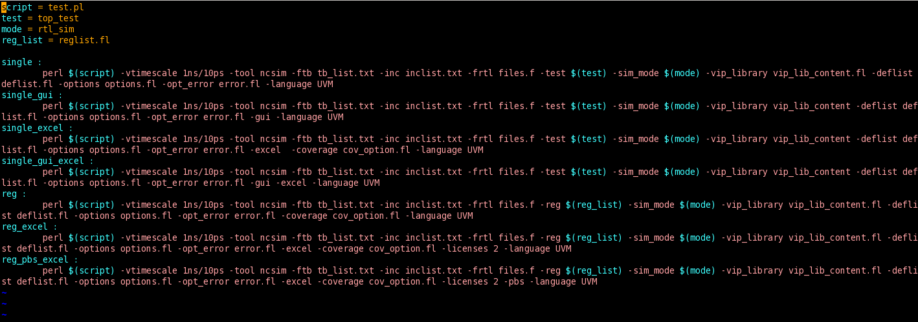
MAKEFILE
This is a feature of Linux that contains the command line code the file. This makes the execution easier as a lot is not necessary to be written in the command line. An example is shown below

Slide 13
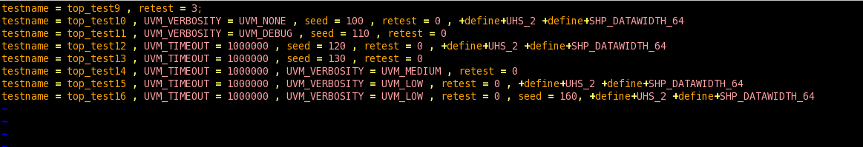
REGLIST
This contains the list of the testcases name that are to be used for running the regression list. This file can be stored in any kind of file extension. An example is shown below with all kinds of possible situations

Slide 14
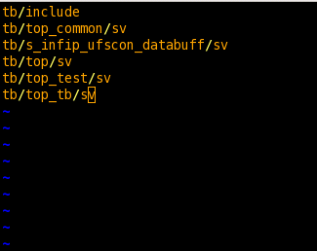
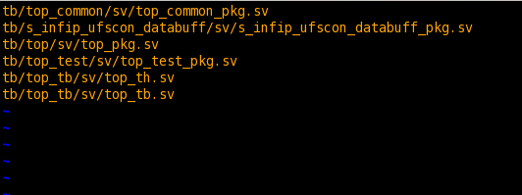
INCLIST AND TB LIST
INCLIST Contains the list of directories that have to be included.
TB List contains the list of the Verilog files required for the project to execute.
TB_LIST
INCLIST

Slide 15
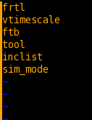
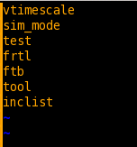
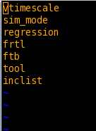
MANDATORY OPTIONS
This options is definitely required for script to execute properly. The names of these files have to be fixed.
MANDATORY COMPILE
MANDATORY SINGLE
MANDATORY REGRESSION

Slide 16
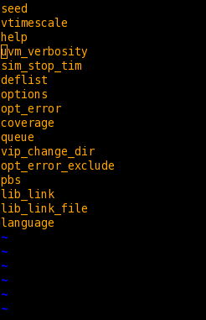
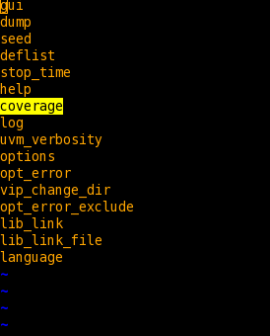
NON MANDATORY OPTIONS
These options can added extra by the user according to the project requirement. This consist of all the possible non-mandatory options. The name of these files need to be fixed.
OPTIONAL REGRESSION
OPTIONAL SINGLE

Slide 17
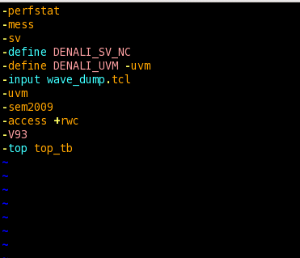
OPTIONS (EXTRA)(NON-MANDATORY)
This are those options that could be added by the users according to the project if required. A example of this list is shown below:

Slide 18
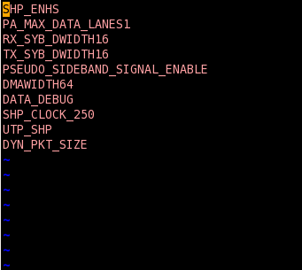
DEFLIST
This list contains the define statement which user might user for any project A snapshot is shown below

Slide 19

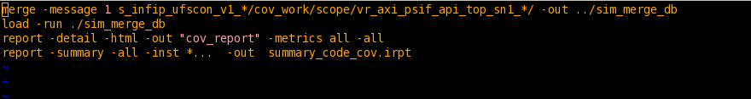
COVERAGE
This option is used to find the coverage of the testcases. Any kind of coverage can be found. The user can see a coverage report at the end.
Option given by user, through an input file, to tell which kind of coverage is needed
Some lines of code written, executed after all the testcases are over. The name of this file needs to be imc_code.cmd

Slide 20
DIRECTORY STRUCTURE BEFORE EXECUTING SCRIPT
ROOT PROJECT
Design
Verification
Env_source
Scripts
Sim
Testbenches
Testcases

Slide 21
DIRECTORY STRUCTURE AFTER EXECUTING SCRIPT
ROOT PROJECT
Design
Verification
Env_source
Regression
Scripts
Sim
Testbenches
Testcases
Rtl_sim
Cov_sim
Vip_dir

Slide 22
SIMULATION DIRECTORY AFTER EXECUTION (DIRECTORIES CREATED)
Sim
Rtl_sim
Cov_sim
Vip_dir
create_vip.sh
Single Test
Reglist
Common_Libs
Common_Libs
Top_Test
Test12
Top_Test1

Slide 23
COMPILATION DIRECTORY
Common_Libs
Compile_ncsim.sh
Wave_dump.tcl
INCA_LIBS
irun.log
Ncperfstat.out
During compilation, Elaboration is done to save the snapshot.
This INCA libs created is referred during simulation from the sim directory.
If INCA libs already exists, then irun takes care of the time stamp of files and then proceeds or skips the elaboration process
The INCA libs directories is not referred if define statement is given in the regression list
This INCA libs directories is also not referred if user has given an option to compile again

Slide 24
SIMULATION DIRECTORY
Top_Test
Top_test.sh
Top_test.log.gz
iruns
During simulation each test has a different directory which consists of the bash file (.sh) and the log file created
The log file is zipped after it is completely created.
The other files that are created during the execution are removed after the execution of the bash file is over
For regression, there are two methods to submit jobs, sequentially or parallel (PBS)

Slide 25
PBS
A salient attribute of this script is the use of PBS (Portable Batch System)
This makes execution of testcases simultaneously, which in turn makes the overall process faster.
qsub – to submit jobs
qstat – to check the number of jobs running, according to the given queue and no of licenses.
No of licenses - 5
Jobs submitted
TestN.sh
Test10.sh
Test9.sh
Test1.sh
Test8.sh
Test7.sh
Test6.sh
Test2.sh
Test5.sh
Test3.sh
Waiting in QUEUE
Test4.sh

Slide 26
REGRESSION DIRECTORY STRUCTURE
Regression
Rtl_sim
Cov_sim
Reglist
reglist1
Reg_temp
Failed
Contains log files that have failed
Passed
Contains log files that have passed
Report
Summary_Report.xls

Slide 27
REPORTS GENERATED

Slide 28
EXCEL REPORT
An excel sheet is created when the script is first executed
This excel sheet gets updated after every test completion
The following information is present in the excel file
Test name
Status(Passed/Failed)
Seed Value
Warnings (OVM/UVM)
Sim Time
Sim Start Time
Sim End Time
Test Start Date
Test End Date
CPU Usage Information
After all the test have been executed the total number of passed and failed is printed along with the total simulation time

Slide 29
EXCEL REPORT SNAPSHOT (SINGLE)

Slide 30
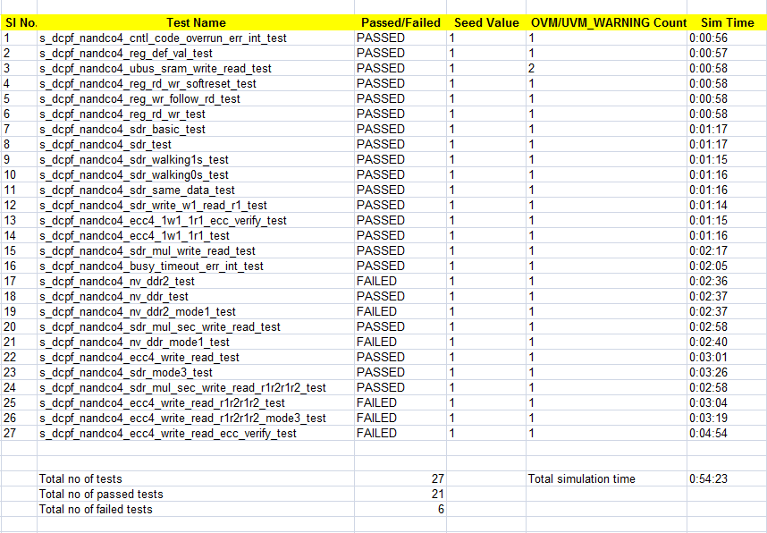
EXCEL SHEET SNAPSHOT (REGRESSION)

Slide 31
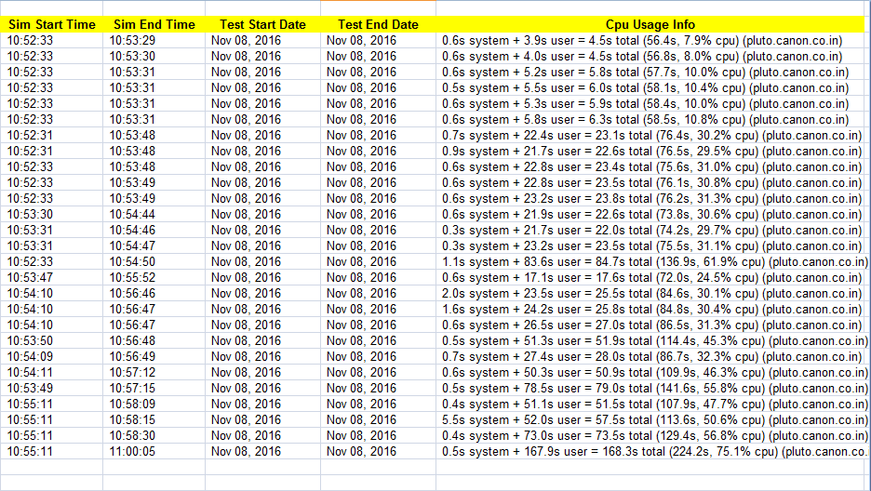
EXCEL REPORT SNAPSHOT (REGRESSION)

Slide 32
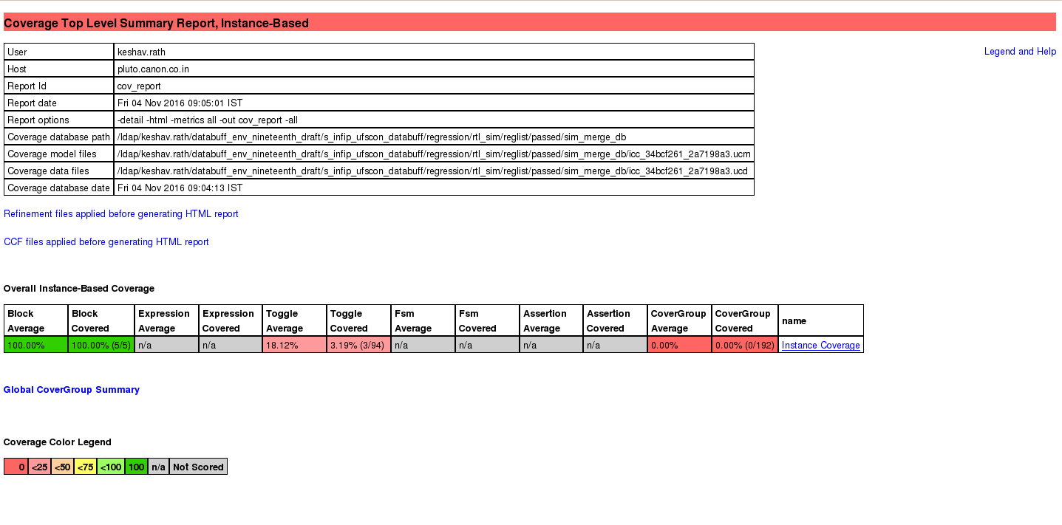
COVERAGE REPORT
A coverage report is generated if the user has enabled the option. This report is generated as a web page for the testcases that have passed.

Slide 33
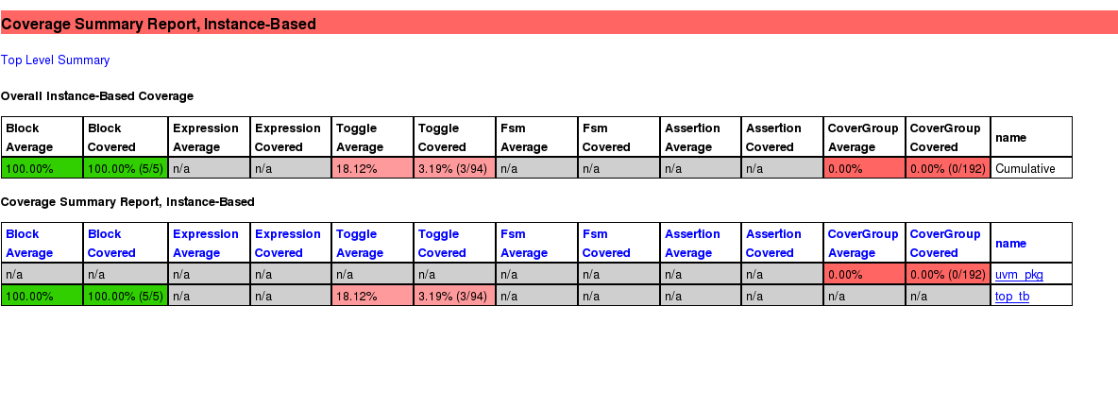
COVERAGE REPORT

Slide 34
CHALLENGES FACED
Submitting jobs in the queue, checking every time when a job gets over
Counting all the types of errors in the log file. (UVM_ERROR, assertion error and optional error)
Differentiating between optional errors and optional errors that have to be excluded, especially errors containing escapes characters.
Make several steps of compilation in modelsim to a single step, same for simulation

Slide 35
COMMON IMPROVEMENT
For regression, the compilation is done one time and the snapshots are stored in a shared library. This in turn saves time
With the help of PBS, submitting jobs in a parallel manner is possible, making more than one test possible to run simultaneously, saving time
Results are short and in a common format across all projects
With excel sheet, no need to wait for all the testcases to get over. Results for all the testcases that are over is available in the excel sheet
All the input are user defined, nothing been fixed in the script.

Slide 36
RESULTS
PROJECT | ENVIRONMENT | SCRIPT | KEY IMPROVEMENTS | TEST STATUS
UFSCON | SV/UVM/Cadence |  | Time reduced by 75% | Complete
PHY | Specman/Cadence |  | PBS | 2-3 test executed
NANDC | SV/UVM/Cadence |  | Time reduced by 75% | Complete
ECC | OVM/Cadence | Lib_link, Lib_Link_file | Time reduced by 83% | Complete
SDCON | OVM/Modelsim |  | Compilation and Simulation shorten | 2-3 test

Slide 37
WORK PENDING
Making the simulation time column in the excel file dynamic.
For modelsim, printing the cpu usage info
Removing files that are generated from scripts.
Removing the extra dots that are present in seed value (only modelsim)

Slide 38
FUTURE WORK
The script can be made more generic if analyzed properly.
Unwanted variables and subroutines can be removed.
Variables can be assigned dynamically so as to reduce space complexity
GUI can be made to make user more comfortable rather than using Makefile, as no command would be required.
GUI can have the use of text boxes, radio buttons, check boxes, so that user can provided all the necessary files and values through the GUI

Slide 39
THANK YOU
Q&A

